Slide 1
System Programming
File Management

Slide 2
Parts of the UNIX OS
H/V
Kernel
Shell
Tools&Apps

Slide 3
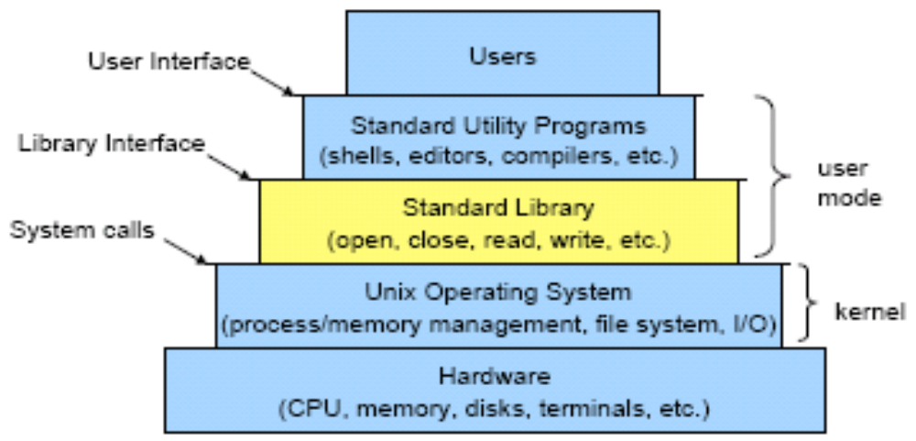
Layers in a Unix-based System

Slide 4
UNIX System Programming
Programming that uses special features of the Unix system (kernel)
Programs make system calls via libraries
Types of system calls
  File I/O
  Process Management
  Inter-Process Communication (IPC)
  Signal Handling

Slide 5
C versus C++
No string data types
  Use character arrays instead
  Use strcpy(), strncpy(), strcmp(), strncmp() to “assign” and compare character arrays
No embedded declarations
  Must declare all variables at the beginning of a code block
Very different File and Standard I/O functions
  printf() versus cout
  scanf() and fgets() versus cin

Slide 6
Basic File I/O
Remember everything in Unix is a file
Kernel maintains a list of open files for each process
Files can be opened for reading, writing
Must include <stdio.h> to use I/O system calls
  Note: Some of the system calls used to interact with the Unix kernel are also available in other OS’. However, they may be (probably are) implemented much differently and some are not available at all.

Slide 7
Basic File I/O (cont.)
Each file is referenced by a file descriptor (an integer)
Three files are opened automatically
  FD 0: standard input
  FD 1: standard output
  FD 2: standard error
When a new file is opened, it is assigned the lowest available FD
man –s 2 <systemcall> (for more information)

Slide 8
open()
fd = open(path, flags, mode);
path: char*, absolute or relative path
flags:
  O_RDONLY – open for reading
  O_WRONLY – open for writing
  O_RDWR – open for reading and writing
  O_CREAT – create the file if it doesn’t exist
  O_TRUNC – truncate the file if it exists (overwrite)
  O_APPEND – only write at the end of the file
mode: specify permissions if using O_CREAT
Returns newly assigned file descriptor
fd = open(”myfile”, O_CREAT, 00644)

Slide 9
read()
bytes = read(fd, buffer, count);
Read from file associated with fd; place count bytes into buffer
fd: file descriptor to read from
buffer: pointer to array of count bytes
count: maximum number of bytes to read
Returns the number of bytes read or -1 on error
int fd = open("someFile", O_RDONLY);
char buffer[4];
int bytes =
read(fd, buffer, 4);

Slide 10
write()
bytes = write(fd,buffer, count)
Write contents of buffer to a file associated with fd
fd: file descriptor
buffer: pointer to an array of count bytes
count: number of bytes to write
Returns the number of bytes written or -1 on error
int fd = open("someFile", O_WRONLY);
char buffer[4];
int bytes =
write(fd, buffer, 4);

Slide 11
close()
return_val = close(fd)
Closes an open file descriptor
Returns 0 on success, -1 on error

Slide 12
lseek()
retval = lseek(fd,offset,whence)
Move file pointer to new location
fd: file descriptor
offset: number of bytes
whence: .
  SEEK_SET – offset from beginning of file
  SEEK_CUR – offset from current offset location
  SEEK_END – offset from end of file
Returns offset from beginning of file or –1 on error

Slide 13
File I/O using FILES
Most Unix programs use higher-level I/O functions
  fopen()
  fread()
  fwrite()
  fclose()
  fseek()
These use the FILE datatype instead of file descriptors
Need to include <stdio.h>

Slide 14
fopen()
FILE *file_stream = fopen(path, mode);
path: char*, absolute or relative path
mode:
  r – open file for reading
  r+ – open file for reading and writing
  w – overwrite file or create file for writing
  w+ – open for reading and writing; overwrites file
  a – open file for appending (writing at end of file)
  a+ – open file for appending and reading
fclose(file_stream);
  Closes open file stream

Slide 15
Using datatypes with file I/O
All the functions we’ve seen so far use raw bytes for file I/O, but program data is usually stored in meaningful datatypes (int, char, float, etc.)
fprintf(), fputs(), fputc()
  Used to write data to a file
fscanf(), fgets(), fgetc()
  Used to read data from a file
man <function> (for more info)

Slide 16
printf()
printf(format_string,x,y,...)
format_string: string that describes the output information
  formatting commands are escaped with %
x,y,...: values to print according to formatting commands in format_string

Slide 17
Formatting Commands
%d, %i – decimal integer
%u – unsigned decimal integer
%o – unsigned octal integer
%x, %X – unsigned hexadecimal integer
%c - character
%s – string or character array
%f – float
%e, %E – double (scientific notation)
%g, %G – double or float
%% - print a % character

Slide 18
printf() Examples
printf("The sum of %d, %d, and %d is %d\n", 65, 87, 33, 65+87+33);
  Output: The sum of 65, 87, and 33 is 185
printf("Character code %c has ASCII code %d.\ n", 'A', 'A');
  Output: Character code A has ASCII code 65.
printf("Error %s occurred at line %d\n", emsg, lno);
  emsg and lno are variables
  Output: Error invalid variable occurred at line 27

Slide 19
printf() Examples (cont.)
printf("Octal form of %d is %o \n", 59, 59);
  Output: Octal form of 59 is 73
printf("Hexadecimal form of %d is %x \n", 59, 59);
  Output: Hexadecimal form of 59 is 3B
printf("Square root of 2 is %f \n", sqrt( 2.0));
  Output: Square root of 2 is 1.414214

Slide 20
printf() Examples (cont.)
printf("Square root of 157 is %e \n", sqrt( 157.0));
  Output: Square root of 157 is 1.252996e+01
printf("You scored %d out of %d for %d%%.\n", 17, 25, 68);
  Output: You scored 17 out of 25 for 68%.

Slide 21
scanf()
scanf(format_string,&x,&y,...)
Similar syntax to printf, except format_string specifies data to read
Must pass variables by reference
Example
  scanf("%d %c %s", &int_var,
  &char_var, string_var);

Slide 22
printf() and scanf() Families
fprintf(file_stream, format_string, ...)
  Prints to a file stream instead of stdout
sprintf(char_array, format_string, ...)
  Prints to a character array instead of stdout
fscanf(file_stream, format_string, ...)
  Reads from a file stream instead of stdin
sscanf(char_array, format_string, ...)
  Reads from a string instead of stdin

